Slide 1
Constructing the A-matrix
Dr Dean Connor

Slide 2
D1
D1
D1
D1
Drone Measurements
G1
G2
Ground Points
G3
G4
G5

Slide 3
Constituents of radiation transport: Geometrical Contributions
Point sources emit radiation isotropically – meaning equally in all directions
Source activity is measured in Bq, which is defined as one nuclear disintegration per second.
1000 Bq = 1000 disintegrations per second
We’re going to term the activity as A_{x}
Not every disintegration of a nucleus emits a gamma ray.
The gamma yield (Y) describes the percentage emitted per decay.
Therefore, the number of gamma rays emitted is A_{x}Y (the pink circle at a given distance).
Only a portion of emitted gamma rays are emitted towards the detector and only this portion can be detected by the detector and count towards our detector intensity.
The portion emitted towards the detector is defined by the geometrical efficiency. We term this as Ω.
For point sources, we can replace this with the detector surface area * inverse square law. s.a * 1/4πR², where R is the source:detector distance.
Technically, we should scale this by the presented surface area of the detector to the source. Can omit this for this work

Slide 4
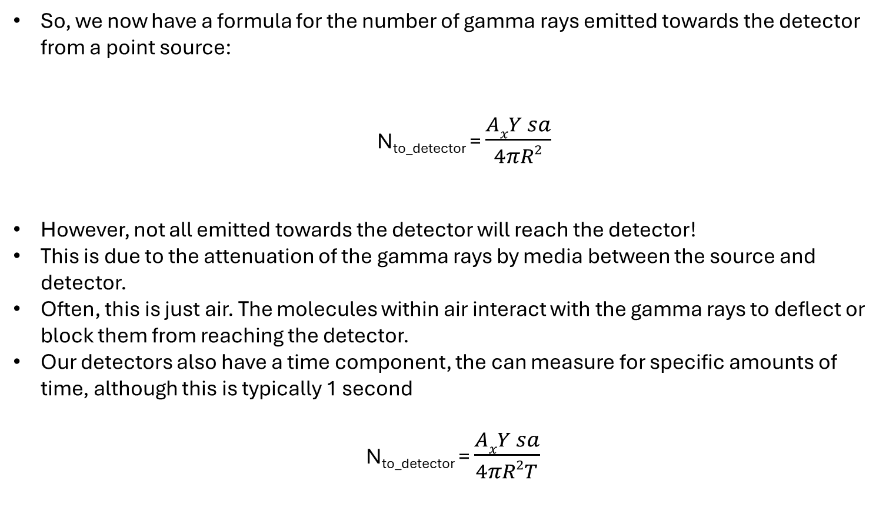
Constituents of radiation transport: Geometrical Contributions
So, we now have a formula for the number of gamma rays emitted towards the detector from a point source:
N_{to_detector} = $\frac{AxY sa}{4πR2}$
However, not all emitted towards the detector will reach the detector!
This is due to the attenuation of the gamma rays by media between the source and detector.
Often, this is just air. The molecules within air interact with the gamma rays to deflect or block them from reaching the detector.
Our detectors also have a time component, the can measure for specific amounts of time, although this is typically 1 second
N_{to_detector} = $\frac{AxY sa}{4πR2T}$

Slide 5
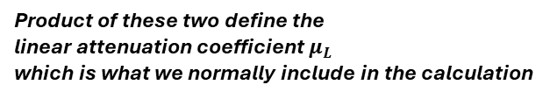
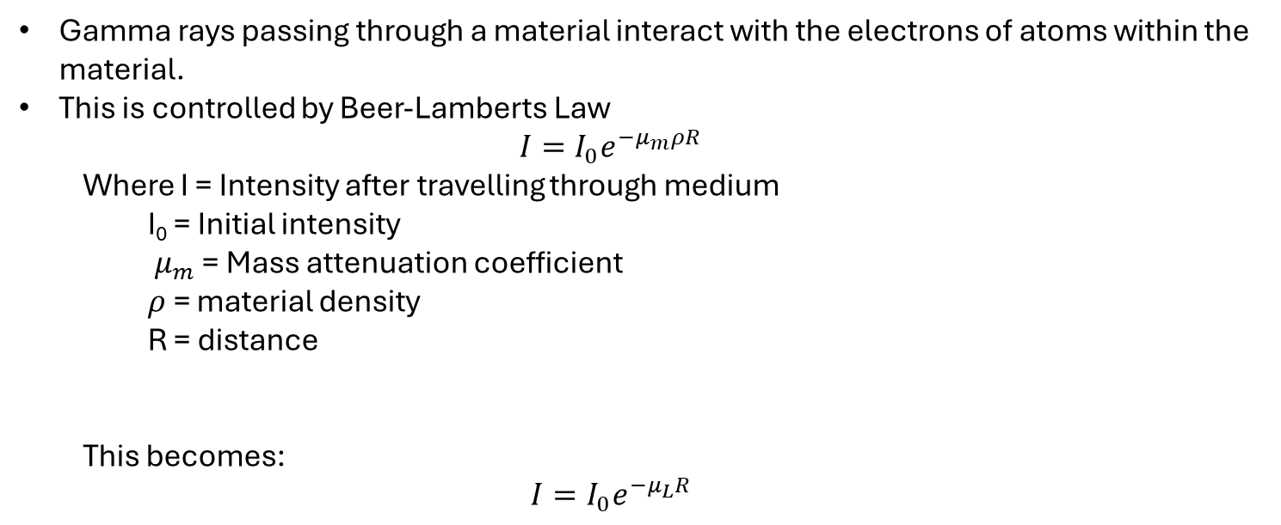
Constituents of radiation transport: Attenuation
Gamma rays passing through a material interact with the electrons of atoms within the material.
This is controlled by Beer-Lamberts Law
$$I=I_{0}e^{−μ_{m}ρR}$$
Where I = Intensity after travelling through medium
I₀ = Initial intensity
$μ_{m}$ = Mass attenuation coefficient
$ρ$ = material density
R = distance
This becomes:
$$I=I_{0}e^{−μ_{L}R}$$
air
Product of these two define the linear attenuation coefficient $μ_{L}$ which is what we normally include in the calculation

Slide 6
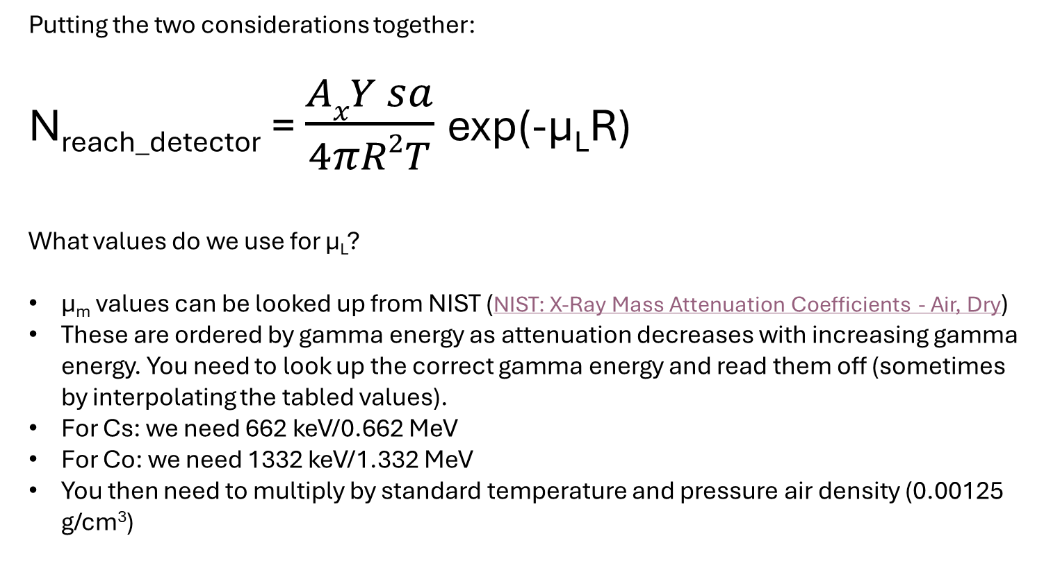
Attenuation + Geometrical Considerations
Putting the two considerations together:
N_{reach_detector} = $\frac{AxY sa}{4πR2T}$exp(-µ_{L}R)
What values do we use for µ_{L}?
µ_{m} values can be looked up from NIST (NIST: X-Ray Mass Attenuation Coefficients - Air, Dry)
These are ordered by gamma energy as attenuation decreases with increasing gamma energy. You need to look up the correct gamma energy and read them off (sometimes by interpolating the tabled values).
For Cs: we need 662 keV/0.662 MeV
For Co: we need 1332 keV/1.332 MeV
You then need to multiply by standard temperature and pressure air density (0.00125 g/cm³)
air

Slide 7
Constituents of radiation transport: Detection Efficiency
Detectors do not necessarily record counts from every gamma ray that enters the detection volume.
Some will be detected, some will pass straight through, and some will deflect without transferring energy to the detector. Energy transfer is the mechanism by which detections are recorded.
It is a bit more complicated than the bullet above, but this is a decent overview.
Detection efficiency is expressed as a percentage of the available gamma rays that are detected.
We denote efficiency using ε_{x} where x denotes the gamma energy (as with A_{x} in the earlier slides). Detection efficiency, like attenuation, reduces as gamma energy increases.
In fact, detections are just the recordings of a device that deliberately tries to attenuate a radiation field. They are constructed of materials that produce measuruable signals on contact with radiation fields and that have preferential properties to encourage attenuation to occur.

Slide 8
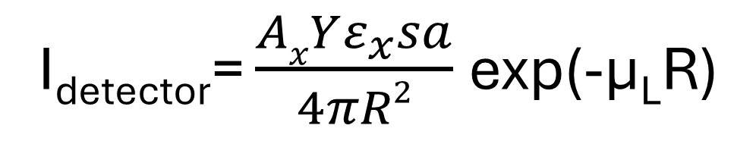
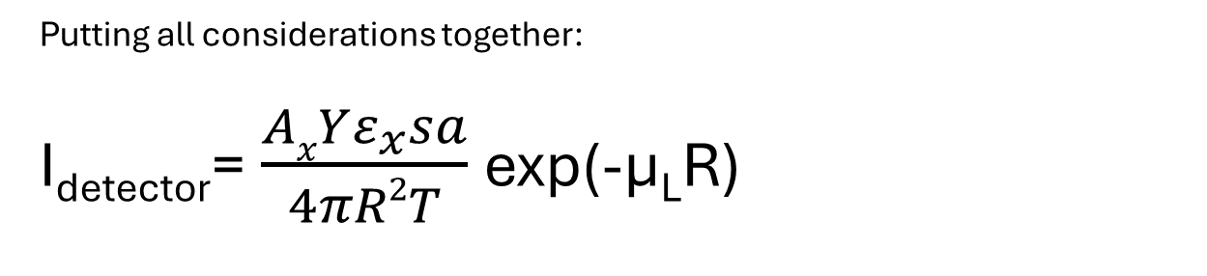
The whole radiation transport equation
Putting all considerations together:
I_{detector}= $\frac{AxYε_{x}sa}{4πR2T}$exp(-µ_{L}R)
air
This is our forward transport model that describes the expected detector intensity for a given measurement time.
However, your results are already normalised for time, so we don’t need to consider it here.
I_{detector}= $\frac{AxYε_{x}sa}{4πR2}$exp(-µ_{L}R)

Slide 9
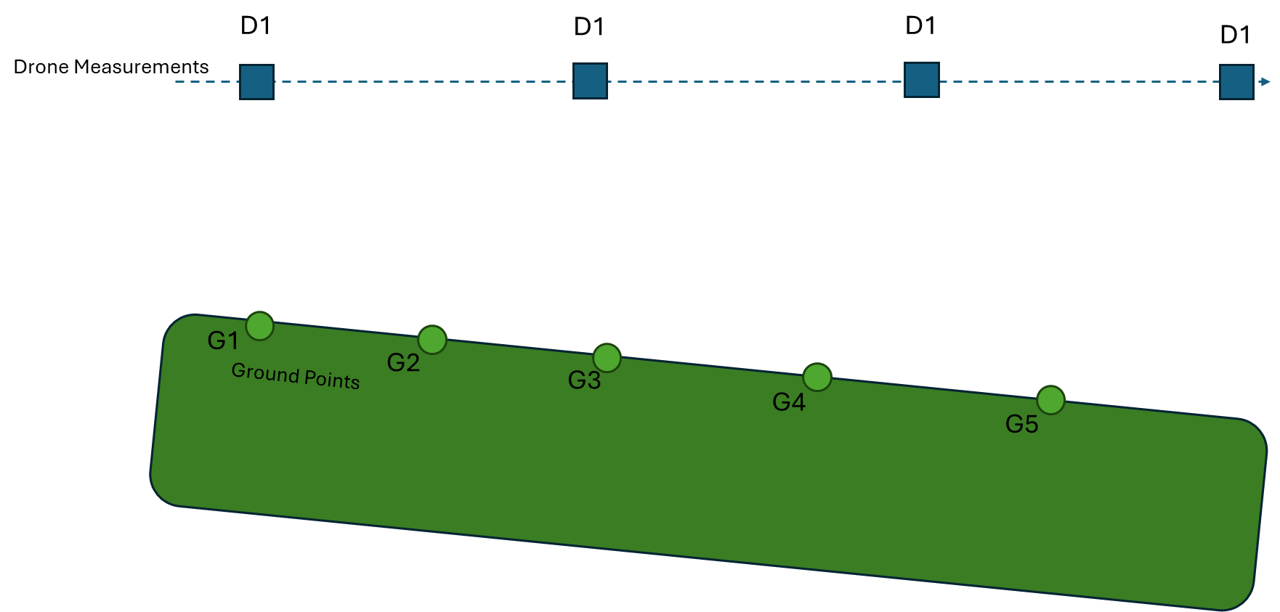
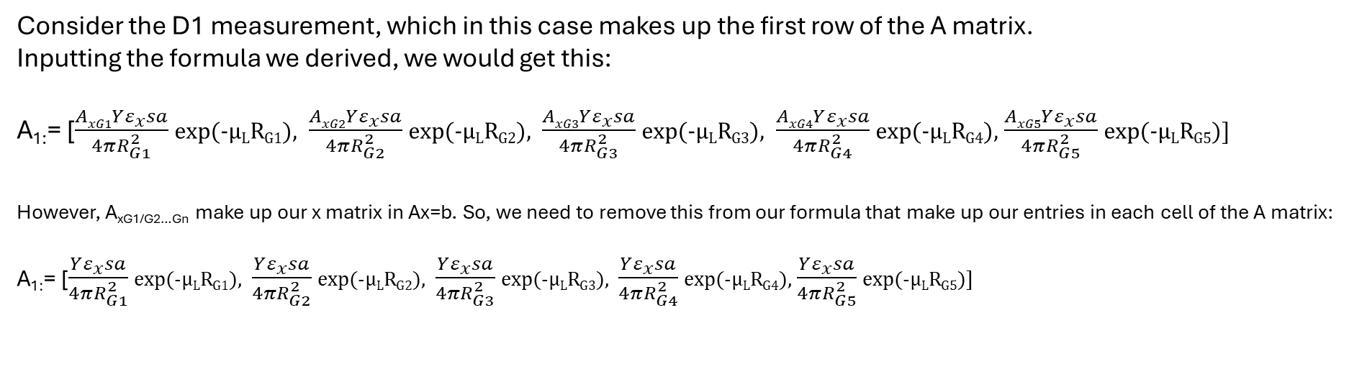
Setting up the A-matrix
Consider the D1 measurement, which in this case makes up the first row of the A matrix.
Inputting the formula we derived, we would get this:
A_{1:}= [$\frac{AxG1Yε_{x}sa}{4πR_{G1}^{2}}$exp(-µ_{L}R_{G1}), $\frac{AxG2Yε_{x}sa}{4πR_{G2}^{2}}$exp(-µ_{L}R_{G2}), $\frac{AxG3Yε_{x}sa}{4πR_{G3}^{2}}$exp(-µ_{L}R_{G3}), $\frac{AxG4Yε_{x}sa}{4πR_{G4}^{2}}$exp(-µ_{L}R_{G4}), $\frac{AxG5Yε_{x}sa}{4πR_{G5}^{2}}$exp(-µ_{L}R_{G5})]
However, A_{xG1/G2…Gn} make up our x matrix in Ax=b. So, we need to remove this from our formula that make up our entries in each cell of the A matrix:
A_{1:}= [$\frac{Yε_{x}sa}{4πR_{G1}^{2}}$exp(-µ_{L}R_{G1}), $\frac{Yε_{x}sa}{4πR_{G2}^{2}}$exp(-µ_{L}R_{G2}), $\frac{Yε_{x}sa}{4πR_{G3}^{2}}$exp(-µ_{L}R_{G3}), $\frac{Yε_{x}sa}{4πR_{G4}^{2}}$exp(-µ_{L}R_{G4}), $\frac{Yε_{x}sa}{4πR_{G5}^{2}}$exp(-µ_{L}R_{G5})]
R_{G1}
R_{G2}
R_{G3}
R_{G4}
R_{G5}

